Slide 1
About Us
Olorunyomi Babatunde Foundation (OBF)
The Olorunyomi Babatunde Foundation (OBF) is a non-profit organisation dedicated to promoting academic honesty and ethical leadership among adolescents and young people. We design and implement school outreach campaigns, community sensitisation programmes, and youth empowerment initiatives that reduce exam malpractice and open alternative, honourable pathways to success. OBF works with educators, parents, community and religious leaders to create lasting, systemic change in the culture of learning across communities.
Why we exist:
Academic integrity is the bedrock of meaningful learning and social trust. When young people are supported to succeed through skill, perseverance and integrity, communities benefit from stronger leaders, entrepreneurs and citizens. OBF exists to shift mindsets, strengthen institutions, and support young people to thrive honestly.

Slide 2
Our Goal
To end exam malpractice and foster a culture of integrity among Nigeria’s young people while providing them with the skills and support to pursue ethical success.
Three core aims
Change Mindsets: Sensitise schools and communities about the harms of exam malpractice and the value of academic honesty.
Empower Youth: Deliver life-skills, leadership, and entrepreneurship training so students can pursue legitimate paths to success.
Influence Systems: Work with educators, parents, and community leaders to strengthen policies and practices that support integrity in education.

Slide 3
Vision:
A future where every young person pursues education and success with integrity, skill and dignity.
Mission:
We promote academic honesty and equip young people with life skills, ethical leadership training and practical alternatives to dishonest academic practices. Through school outreach, stakeholder engagement and targeted programmes, we change mindsets, strengthen institutions, and open real pathways to personal and community development.

Slide 4
1. Promote academic honesty and integrity: Through sensitization campaigns, school outreach programmes and value-based education, we work to change mindsets and discourage exam malpractice among adolescents and young people.
2. Empower youth with skills and alternatives: We deliver life skills, ethical leadership training, and entrepreneurship support that reduce reliance on dishonest academic shortcuts and encourage responsible citizenship.
3. Engage stakeholders for systemic reform: We collaborate with educators, parents, religious and community leaders to strengthen ethical standards in educational institutions and support community-led integrity movements.
AIMS AND OBJECTIVES

Slide 5
OUR BOARD OF TRUSTEES
The Olorunyomi Babatunde Foundation is guided by a diverse Board of Trustees that brings together experience in education, law, community engagement and youth development. The Board provides strategic oversight, ensures accountability, and steers the Foundation toward impactful programmes and sustainable growth.
Governance statement:
The Board meets quarterly, approves the annual strategy and budget, and ensures the Foundation maintains high standards of governance and safeguarding.

Slide 6
Professor Oyelade Olutunji Sunday is an accomplished entrepreneur and respected community leader with decades of experience in business development and organisational governance. His leadership brings stability, foresight, and strategic guidance to the Foundation. He plays a central role in steering OBF’s mission to promote academic integrity and youth empowerment across communities.
Professor Oyelade Olutunji
Chairman, Board of Trustees

Slide 7
Olorunyomi Emmanuel Babatunde is an entrepreneur and visionary whose passion for youth development and academic integrity inspired the establishment of OBF. With years of experience in community engagement and business leadership, he provides strategic support to the Foundation’s operations and long-term growth.
Olorunyomi Emmanuel Babatunde
Trustee

Slide 8
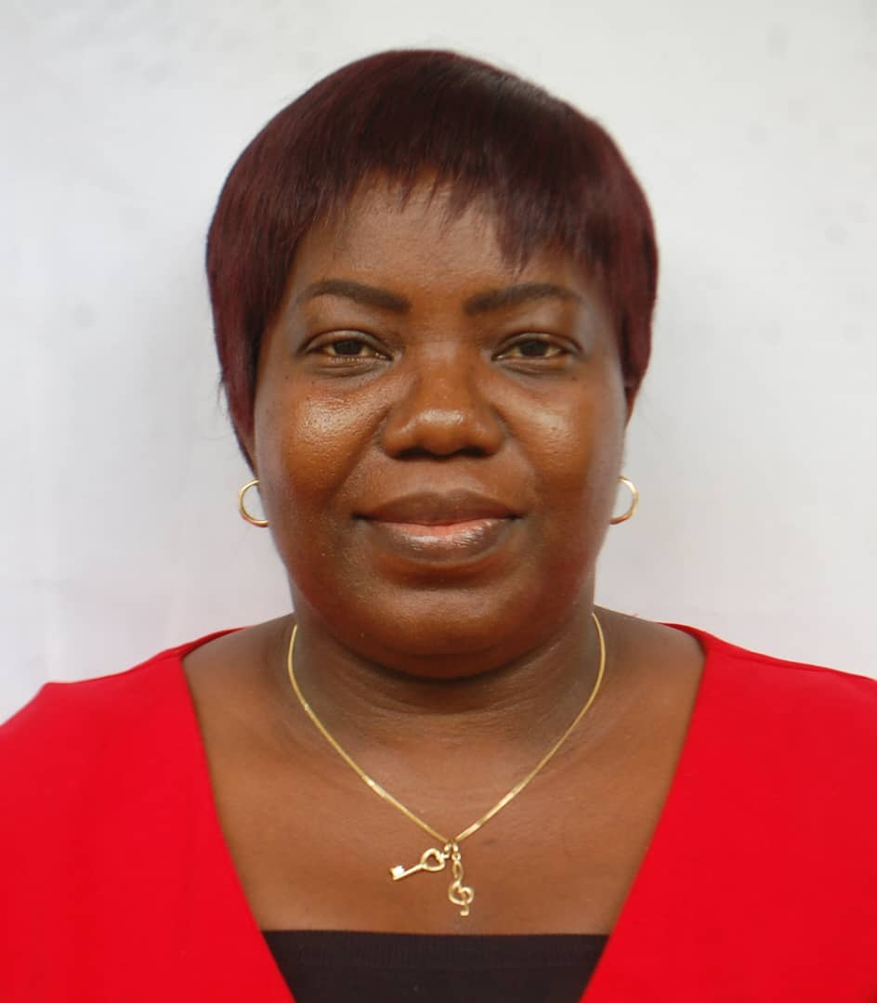
Ifeoluwa Babatunde is a seasoned accountant with vast experience in financial management and internal controls. She oversees the Foundation’s treasury, ensuring transparency, accountability, and compliance with non-profit financial standards. Her expertise strengthens OBF’s financial governance systems.
Ifeoluwa Olaitan Babatunde
Treasurer and Trustee

Slide 9
Sikiru Akinyeye Ahmed is a lecturer and education professional with a strong commitment to youth development and ethical learning environments. His academic background and passion for reforming education systems enhance the Foundation’s ability to design impactful school-based programmes.
Sikiru Akinyeye Ahmed
Trustee

Slide 10
Oyinkansola Funwape is an entrepreneur with a strong background in business operations and community development. She brings innovative thinking and organisational skills to OBF’s governance structures and project planning processes.
Funwape Oyinkansola Motunrayo
Trustee

Slide 11
Olalekan Samson Babatunde is an educator with experience in school administration and youth mentoring. As Secretary, he supports the Board by managing documentation, correspondence, and governance processes.
Olalekan Samson Babatunde
Secretary, Non-Trustee

Slide 12



OUR SUSTAINABLE DEVELOPMENT GOALS (SDGs)
OBF aligns its programmes to the following SDGs to ensure measurable impact and global alignment:
SDG 4 — Quality Education
We promote equitable, inclusive and quality education by addressing factors that undermine learning — including exam malpractice — and by supporting skills development.
SDG 3 — Good Health and Well-being
Through value-based education and youth empowerment, we support mental well-being and the creation of healthier, more resilient communities.
SDG 1 — No Poverty
By equipping young people with entrepreneurship skills and alternative pathways to success, we reduce the risk that poverty drives resort to dishonest practices.

Slide 13
Donate (page content + GoFundMe integration copy)
Support Our Work — Donate to OBF
Help us champion academic integrity and empower the next generation!
Donations to OBF fund school outreach programmes, youth skills training, and community engagement activities that reduce exam malpractice and build pathways to honest success. Every donation helps change a life.
How your gift will be used:
School Outreach & Sensitization (40%) — Workshops, school visits and community campaigns.
Youth Empowerment & Skills Training (35%) — Life skills, leadership and entrepreneurship programmes.
Programme Administration & Safeguarding (15%) — Safe, transparent delivery and monitoring.
Monitoring, Evaluation & Learning (10%) — Tracking impact and improving programmes.

Slide 14
FAQs
Is my donation tax deductible? — [Add local/region tax guidance here if applicable.]
How do I get a receipt? — After donating on GoFundMe, you’ll receive an automated email receipt. For receipts from OBF, email: [contact@obf.org
Can I support OBF in other ways? — Yes — volunteer, sponsor a school visit, or partner with us. Contact: [contact@obf.org
Frequently Asked Questions

Slide 15
Footer / Small print (for site bottom)
Contact: info@obf.org
Follow us: [Facebook] [Twitter] [Instagram] (link placeholders)
Legal: Registered non-profit. [Registration number] (add if available). Privacy Policy | Terms of Use.
Copyright line: © 2025. Olorunyomi Babatunde Foundation. All rights reserved.

